Slide 1








AUTOMATED FOOTBALL
OPPOSITION REPORT
From Descriptive Analytics to Prescriptive Tactics
Using Open Spatial Data
Emanuele Colecchia

Slide 2

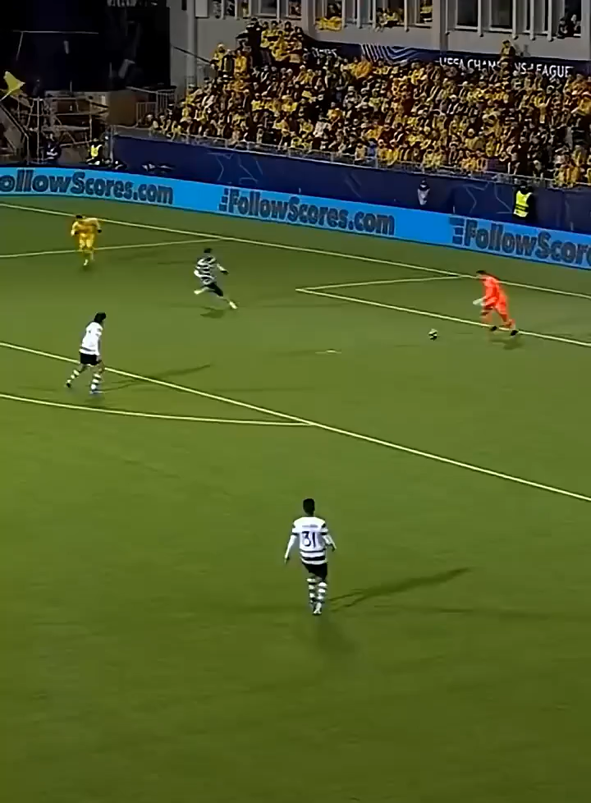

Slide 3
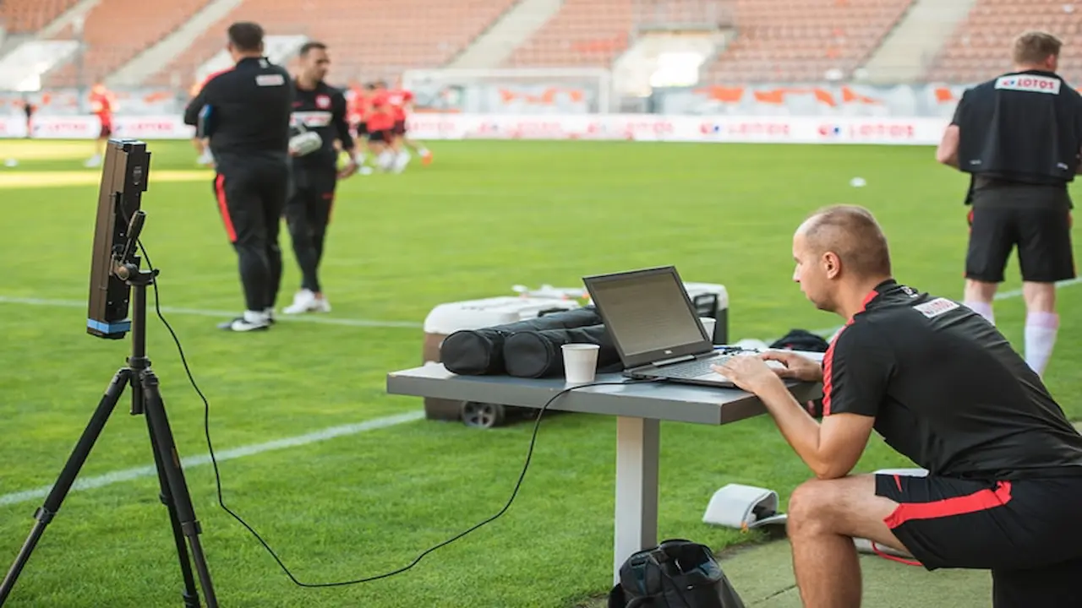
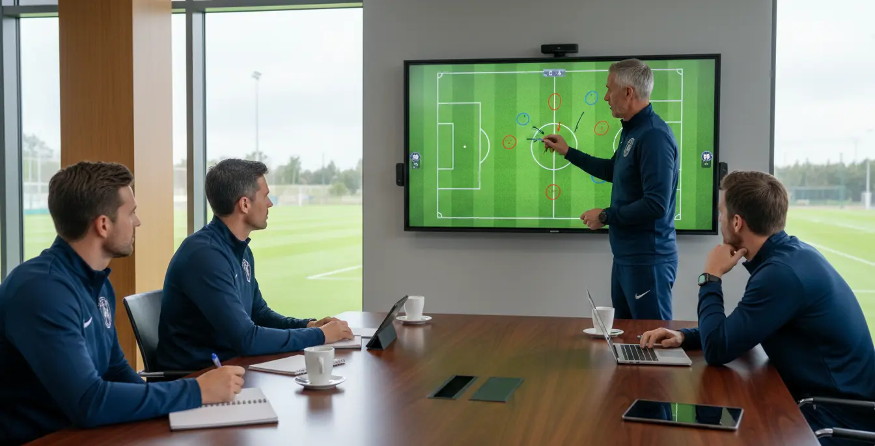

Slide 4

HOW DO WE ATTACK THIS SPECIFIC DEFENSIVE STRUCTURE?' OR 'HOW DO WE DEFEND AGAINST THIS RECURRING MOVEMENT?

Slide 5
EXTRACT TACTICAL PATTERNS FROM EVENT DATA TO MATHEMATICALLY MEASURE THEIR STABILITY, PREDICTABILITY, AND EXPLOITABILITY.

Slide 6
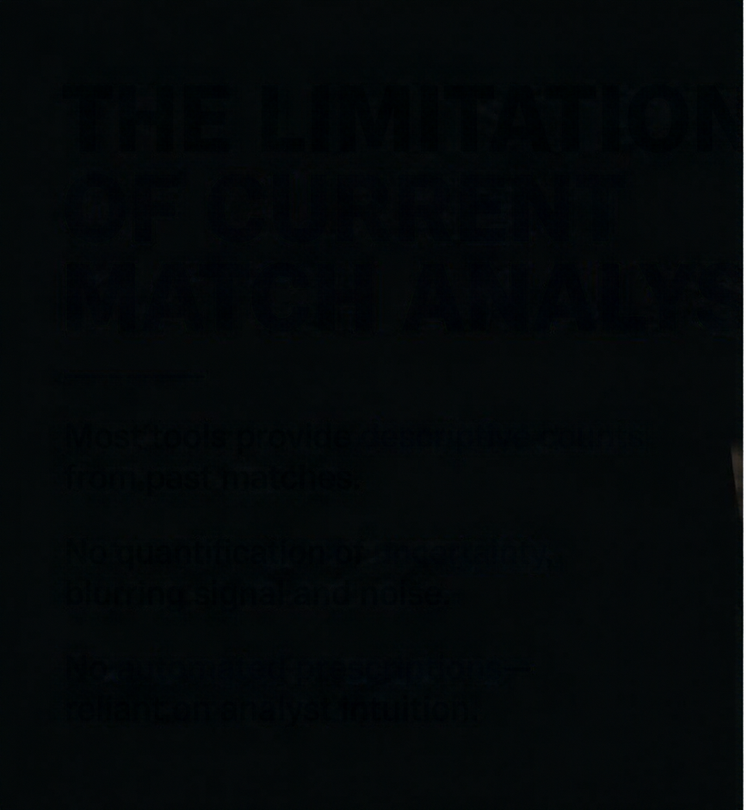


THE LIMITATIONS
OF CURRENT
MATCH ANALYSIS
Most tools provide descriptive counts from past matches.
No quantification of uncertainty, blurring signal and noise.
No automated prescriptions—
reliant on analyst intuition.

Slide 7
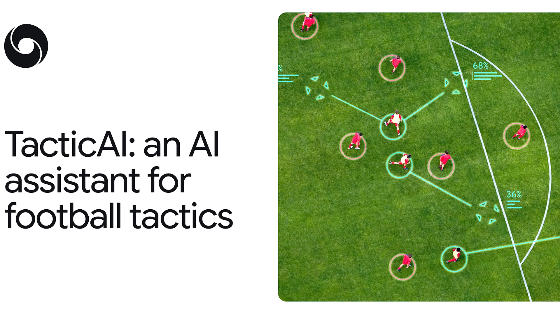




Slide 8
SEPARATE STRUCTURAL SIGNAL
CURRENT TOOLS
FROM RANDOM NOISE
CANNOT

Slide 9
ANALYST ARE FORCED TO RELY ON SUBJECTIVE VISUAL INTUITION

Slide 10

DISCOVERING PATTERN

Slide 11
I WANT TO TAKE THE EVENT DATA OF A FOOTBALL TEAM, FIND THE PATTERNS IT REPEATS, MEASURE WITH MATHEMATICAL UNCERTAINTY HOW STABLE AND HOW PREDICTABLE THOSE PATTERNS ARE, AND TEST WHETHER THAT PREDICTABILITY COULD BE EXPLOITED BY AN OPPONENT.

Slide 12
THE RESEARCH
QUESTION

Slide 13

HOW CAN WE MOVE BEYOND SIMPLY WATCHING A FOOTBALL MATCH, AND INSTEAD MATHEMATICALLY MEASURE THE FREQUENCY, STABILITY, PREDICTABILITY, AND EXPLOITABILITY OF GAME PATTERNS?

Slide 14













The Research Question
How can we move beyond simply watching a football match, and instead mathematically measure the frequency, stability, predictability, and exploitability of game patterns?
Stability
Predictability
Exploitability
If I repeat the analysis on slightly different data,
does the pattern come back?
Given the situation, how well can
I guess what the team will do next, compared with a very simple guess?
If a defence knew the habit,
how much would it gain
in expected goals?
Stability
Predictability
Exploitability
Each measure rests on the previous one.
If a pattern is not stable, measuring its predictability makes no sense.

Slide 15


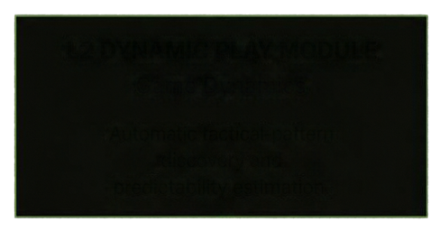
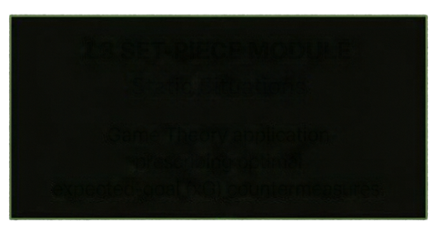





TOWARDS
PRESCRIPTIVE ANALYSIS
A bipartite AI engine that separates dynamic play from static situations to deliver optimal solutions.
AI ENGINE
BIPARTITE MATHEMATICAL ENGINE
Dynamic patterns
learned automatically
from open spatial data.
L2 DYNAMIC PLAY MODULE
L3 SET-PIECE MODULE
Game Dynamics
Static Situations
Automatic tactical-pattern
discovery and
predictability estimation.
Game Theory application
prescribing optimal
expected-goal (xG) countermeasures.
Game theory prescribes
the best expected-goal countermeasures.
From qualitative insights
to uncertainty metrics and tactical payoff optimization.
PATTERN PROBABILITIES
PRESCRIBED COUNTERMEASURES
TACTICAL PAYOFF OPTIMIZATION

Slide 16
A SEQUENCE IS A CHAIN OF PASSES AND CARRIES BY THE SAME TEAM WITHIN ONE POSSESSION
AT LEAST 3 PASSES
1170 SEQUENCES PER TEAM
->

Slide 17
FIRST ATTEMPT
SILHOUETTE SCORE = 0.07-0.11 AND STABILITY < 0.6
PITCH IN 12 ZONES
->

Slide 18
SECOND ATTEMPT
SEGMENTED SEQUENCES AT X=45
SHIFTED TO 11 CONTINOUS VARIABLES TO CAPTURE TRUE GEOMETRIC DISTANCES AND ELIMINATES NOISE
SUCCESSFULLY ISOLATED BACKGROUD NOISE

Slide 19
L2 MODULE :
DISCOVERY AND PREDICTABILITY IN OPEN PLAY

Slide 20
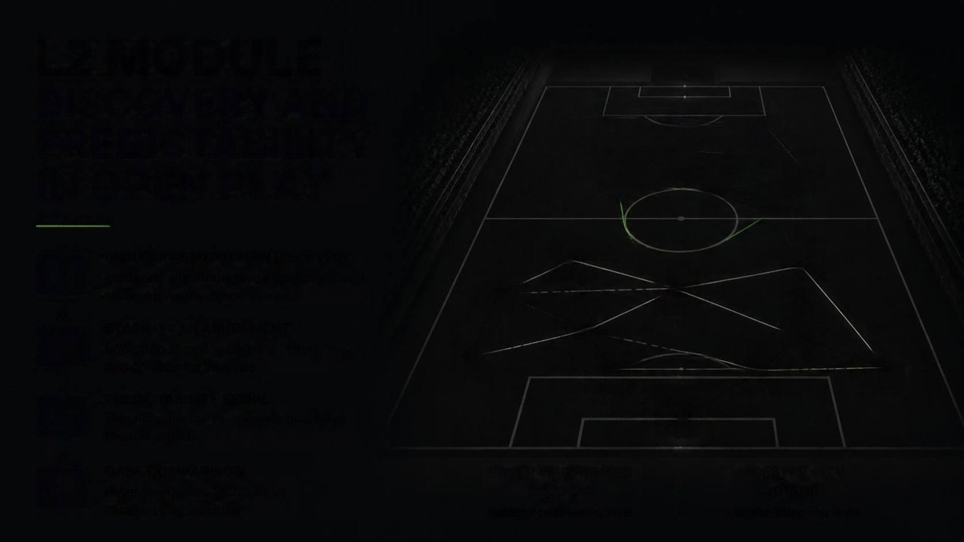
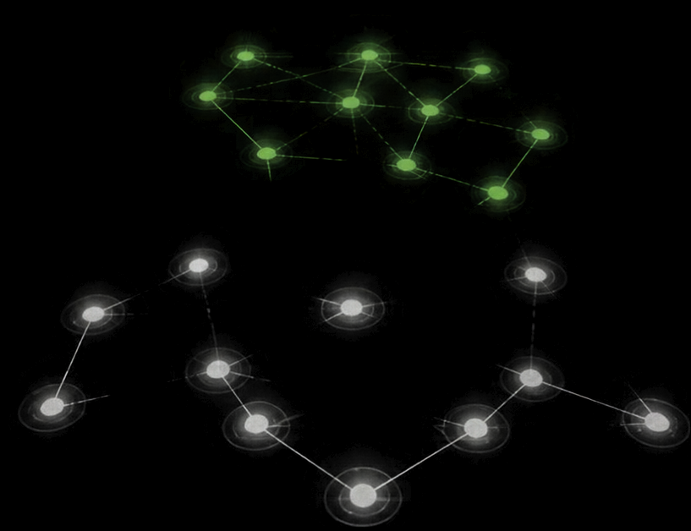







L2 MODULE
DISCOVERY AND PREDICTABILITY IN OPEN PLAY
UNSUPERVISED PATTERN DISCOVERY
01
clustering algorithms reveal spatiotemporal tactical patterns automatically
STABILITY MEASUREMENT
02
bootstrap sampling delivers robustness and confidence intervals
PREDICTABILITY SCORE
03
shannon entropy vs. baseline quantifies tactical rigidity
CASE COMPARISON
BAYER LEVERKUSEN
2023/24
LEICESTER CITY
2015/16
04
bayer leverkusen 2023/24 vs.
leicester city 2015/16
extreme possession style
counter-attacking style

Slide 21
01
STEP 01
UNSUPERVISED PATTERN DISCOVERY
Its centroids are literal (X,Y) vectors on the pitch
An analyst can look at the centroid and instantly understand the tactical shape
To group the sequences:
K-MEANS

Slide 22
02
STEP 02
STABILITY MEASUREMENT
200 iterations
Bootstrap Resampling
Is it pattern or just an anomaly?

Slide 23

03
STEP 03
PREDICTABILITY SCORE
Entropy close to zero indicates that, under pressure, the opponent is predictable and exploitable, because they almost always opt for the long ball.
Shannon Entropy

Slide 24
04
STEP 04
CASE COMPARISON
Put this entire pipeline to the test on real data

Slide 25
HOW DO WE MATHEMATICALLY MEASURE THE SURVIVAL OF OUR CLUSTERS FROM THE
BOOTSTRAP PHASE?

Slide 26
JACCARD INDEX

Slide 27
WHAT IS THE
JACCARD INDEX

Slide 28



Slide 29
L2 MODULE :
TACTICAL PATTERN STABILITY IN ACTION

Slide 30



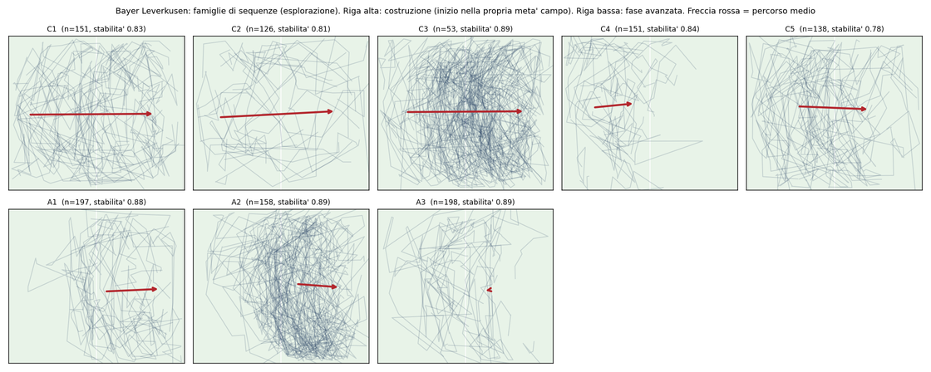
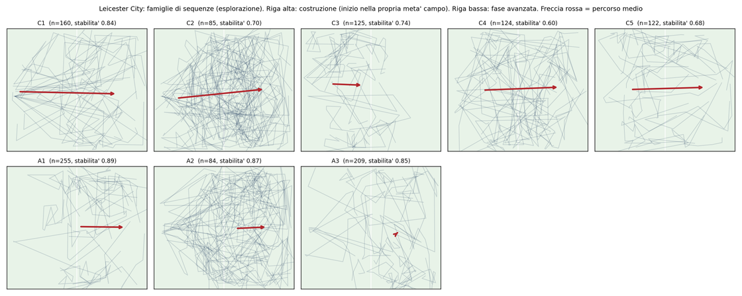

L2 Module: Tactical Pattern Stability in Action
Python-generated sequence fields and Jaccard stability index
Bayer Leverkusen 2023/24
Leicester City 2015/16
Jaccard Index: 0.83
Jaccard Index: 0.71
High stability / tactical rigidity
Lower stability / greater variation
The Python pipeline clusters possession sequences and measures spatial pattern overlap across bootstrap samples.

Slide 31

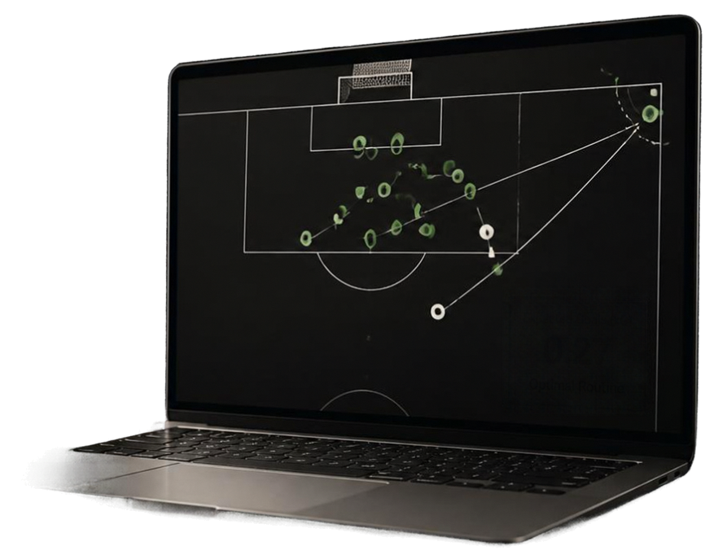

L3 MODULE
GAME THEORY AND EXPLOITABILITY
360° broadcast frames are incomplete during open play.
Complete for corner kicks capturing all defenders.
SPATIAL DATA
CONSTRAINT
GAME THEORY APPLICATION
Geometric mapping of defensive structure simulates offensive options in a zero-sum framework.
Expected Goals (xG)
0.27
PAYOFF OPTIMIZATION
Applies Nash Equilibrium and permutation tests to assess statistically significant vulnerabilities.
Optimal Routine
DATASET ROBUSTNESS
Aggregation of UEFA Euro 2020,
UEFA Euro 2024, and
FIFA World Cup 2022
yielding ~1500 corners.

Slide 32

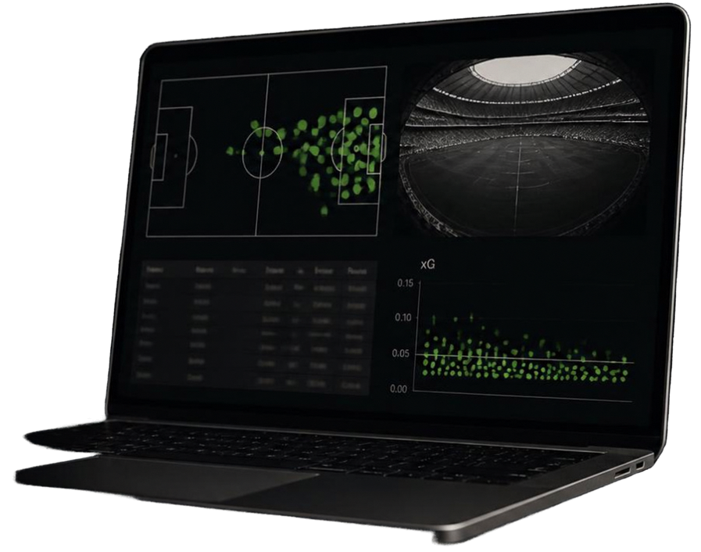

DATASET AND
VALIDATION
METHODOLOGY
Open-Source Data: StatsBomb Open Data combining event data and 360° freeze frames.
Ground Truth: Preliminary stress test validates average baseline xG per corner at 0.046.
Predictive Methodology: Rigorous
out-of-sample testing to validate algorithms.
Independence and Reproductibility: No reliance on proprietary software or external commercial licenses.

Slide 33
DATASET AND
VALIDATION
METHODOLOGY
Bayern Leverkusen: 236 corners, exploitability is 0.026 and p-value is 0.17 -> not distinguishable from chance
National cups: 1538 corners and p-value of 0.41
This does not provide that exploitability does not exists: defender positions are partial and many cells of my table are nearly empty
I WILL STUDY WHETHER AN EFFECT APPEARS AND I WILL REPORT THE RESULT EITHER WAY. A NULL RESULT, IS STILL A RESULT

Slide 34








DEVELOPMENT ROADMAP:
6–7 MONTH PLAN
01
02
03
04
L2 Data Pipeline & Pattern Discovery
L3 Game-Theory Development
Industrial Validation: LASK Linz
Evaluation & Thesis Integration
Large-scale download, cleaning and spatial alignment of event and 360° data; initial unsupervised clustering on Bayer Leverkusen possession sequences.
encode the defensive-structure model and optimise set-piece countermeasures using Expected Goals (xG).
propose testing the algorithm on LASK Linz tracking data to assess robustness in a professional-club environment.
out-of-sample validation, comparison of L2 and
L3 results, and
integration of findings
into the final thesis.

